Slide 1
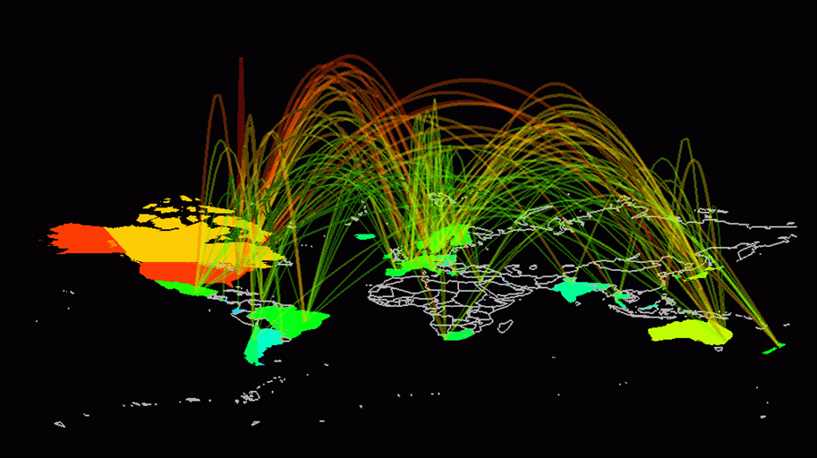
Building scalable heterogeneous internets
Notes:
We have now seen how to build a single network using point-to-point links, shared media, and switches. The problem is that lots of people have built networks with these various technologies and they all want to be able to communicate with each other, not just with the other users of a single network. This topic is about the problem of interconnecting different networks.

Slide 2
Recap
Topic 3: Internetworking
The other LAN may speak/ understand another protocol
(addressing/ framing/ MAC, etc.)
Application
Application
Transport
Transport
Network
Network
Data Link
Data Link
Bits
Bits
Source Host
Router
(L3 Switch)
Destination Host
(Another LAN)
A router / L3 switch inspects destination IP to decide which port(s) to forward to
Notes:
How does routing take place in a single LAN:
Technically speaking, routing is used to connect two different LANs. We use routing here, loosely, to define delivery of the packet to the destination.
The application layer data is prepended with a transport layer header, and then an IP header, and lastly with a MAC header. When the destination node (on the same LAN) receives the frame, it removes the IP address, recognizes its own IP address in the destination field, demuxes the packet to the right application using the Transport layer (TCP or UDP) port information. There is no intermediate routing node enroute.
When the distance between source host and destination host increases, or the number of nodes increase, switches or bridges can be used.
In a hub: a frame is received; it is copied on all other ports; it’s called a physical layer device. Show a frame being copied on all ports.
Motivate the question? Why copy on all ports, when you can just copy to the port the destination MAC is in? This can improve throughput as it will reduce some collisions and enable simultaneous transmissions.
In a switch, the frame is copied to the port destination MAC is connected to; how are the MAC addresses learnt?
A router is used to connect different LANs; An example?

Slide 3
Topic 3: Internetworking
Functions of Network Layer :
To permit different (heterogeneous) networks to be interconnected. It does this by forwarding packets to network routers, which rely on algorithms to determine the best paths for the data to travel.
Fragmentation and Reassembling
Logical Addressing Scheme and Sub-netting
Routing [It does this by forwarding packets to network routers, which rely on algorithms to determine the best paths for the data to travel.]
Notes:
How does routing take place in a single LAN:
Technically speaking, routing is used to connect two different LANs. We use routing here, loosely, to define delivery of the packet to the destination.
The application layer data is prepended with a transport layer header, and then an IP header, and lastly with a MAC header. When the destination node (on the same LAN) receives the frame, it removes the IP address, recognizes its own IP address in the destination field, demuxes the packet to the right application using the Transport layer (TCP or UDP) port information. There is no intermediate routing node enroute.
When the distance between source host and destination host increases, or the number of nodes increase, switches or bridges can be used.
In a hub: a frame is received; it is copied on all other ports; it’s called a physical layer device. Show a frame being copied on all ports.
Motivate the question? Why copy on all ports, when you can just copy to the port the destination MAC is in? This can improve throughput as it will reduce some collisions and enable simultaneous transmissions.
In a switch, the frame is copied to the port destination MAC is connected to; how are the MAC addresses learnt?
A router is used to connect different LANs; An example?

Slide 4

Motivations of Internetworking
No single networking technology is best for all needs
The goal of internetworking is universal service across heterogeneous networks
An Internet router is a special-purpose hardware system dedicated to the task of interconnecting networks. A router can interconnect networks that use different technologies, including different media, physical addressing schemes, or frame formats.
Notes:
From Douglas Comer’s book: (Free chapter on Internetworking from: http://www.netbook.cs.purdue.edu/PDFdocuments/ch20.pdf)
A large organization with diverse networking requirements needs multiple physical networks. More important, if the organization chooses the type of network that is best for each task, the organization will have several types of networks. For example, a LAN technology like Ethernet might be the best solution for connecting computers at a given site, but a leased data circuit might be used to interconnect a site in one city with a site in another.
Concept of Universal Service:
The chief problem with multiple networks should be obvious: a computer attached to a given network can only communicate with other computers attached to the same network. The problem became evident in the 1970s as large organizations began to acquire multiple networks. Each network in the organization formed an island. In many early installations, each computer attached to a single network, and employees had to choose a computer appropriate for each task. That is, an employee was given access to multiple screens and keyboards, and the employee was forced to move from one computer to another to send a message across the appropriate network.
Users are neither satisfied nor productive when they must use a separate computer for each network. Consequently, most modern computer communication systems allow communication between any two computers analogous to the way a telephone system provides communication between any two telephones. Known as universal service, the concept is a fundamental part of networking. With universal service, a user on any computer in any organization can send messages or data to any other user. Furthermore, a user does not need to change computer systems when changing tasks — all information is available to all computers. As a result, users are more productive.
A communication system that supplies universal service allows arbitrary pairs of computers to communicate.
Although universal service is highly desirable, incompatibilities among network hardware, frames, and addresses prevent a bridged network from including arbitrary technologies.
Internetworking
Despite the incompatibilities among network technologies, researchers have devised a scheme that provides universal service among heterogeneous networks. Called internetworking, the scheme uses both hardware and software. Additional hardware systems are used to interconnect a set of physical networks. Software on the attached computers then provides universal service. The resulting system of connected physical networks is known as an internetwork or internet.
The basic hardware component used to connect heterogeneous networks is a router. Physically, a router is an independent hardware system dedicated to the task of interconnecting networks. Like a bridge, a router contains a processor and memory as well as a separate I/O interface for each network to which it connects. The network treats a connection to a router the same as a connection to any other computer.
The figure uses a cloud to depict each network because router connections are not restricted to a particular network technology. A router can connect two LANs, a LAN and a WAN, or two WANs. Furthermore, when a router connects two networks in the same general category, the networks do not need to use the same technology. For example, a router can connect an Ethernet to a Wi-Fi network. Thus, each cloud represents an arbitrary network technology.
An Internet router is a special-purpose hardware system dedicated to the task of interconnecting networks. A router can interconnect networks that use different technologies, including different media, physical addressing schemes, or frame formats.
The goal of internetworking is universal service across heterogeneous networks.

Slide 5
Motivations of Internetworking
Each network technology is designed to fit a specific set of constraints. For example, LAN technologies are designed to provide high-speed communication across short distances, while WAN technologies are designed to provide communication across large areas. Consequently:
No single networking technology is best for all needs.
Notes:
From Douglas Comer’s book: (Free chapter on Internetworking from: http://www.netbook.cs.purdue.edu/PDFdocuments/ch20.pdf)
A large organization with diverse networking requirements needs multiple physical networks. More important, if the organization chooses the type of network that is best for each task, the organization will have several types of networks. For example, a LAN technology like Ethernet might be the best solution for connecting computers at a given site, but a leased data circuit might be used to interconnect a site in one city with a site in another.
Concept of Universal Service:
The chief problem with multiple networks should be obvious: a computer attached to a given network can only communicate with other computers attached to the same network. The problem became evident in the 1970s as large organizations began to acquire multiple networks. Each network in the organization formed an island. In many early installations, each computer attached to a single network, and employees had to choose a computer appropriate for each task. That is, an employee was given access to multiple screens and keyboards, and the employee was forced to move from one computer to another to send a message across the appropriate network.
Users are neither satisfied nor productive when they must use a separate computer for each network. Consequently, most modern computer communication systems allow communication between any two computers analogous to the way a telephone system provides communication between any two telephones. Known as universal service, the concept is a fundamental part of networking. With universal service, a user on any computer in any organization can send messages or data to any other user. Furthermore, a user does not need to change computer systems when changing tasks — all information is available to all computers. As a result, users are more productive.
A communication system that supplies universal service allows arbitrary pairs of computers to communicate.
Although universal service is highly desirable, incompatibilities among network hardware, frames, and addresses prevent a bridged network from including arbitrary technologies.
Internetworking
Despite the incompatibilities among network technologies, researchers have devised a scheme that provides universal service among heterogeneous networks. Called internetworking, the scheme uses both hardware and software. Additional hardware systems are used to interconnect a set of physical networks. Software on the attached computers then provides universal service. The resulting system of connected physical networks is known as an internetwork or internet.
The basic hardware component used to connect heterogeneous networks is a router. Physically, a router is an independent hardware system dedicated to the task of interconnecting networks. Like a bridge, a router contains a processor and memory as well as a separate I/O interface for each network to which it connects. The network treats a connection to a router the same as a connection to any other computer.
The figure uses a cloud to depict each network because router connections are not restricted to a particular network technology. A router can connect two LANs, a LAN and a WAN, or two WANs. Furthermore, when a router connects two networks in the same general category, the networks do not need to use the same technology. For example, a router can connect an Ethernet to a Wi-Fi network. Thus, each cloud represents an arbitrary network technology.
An Internet router is a special-purpose hardware system dedicated to the task of interconnecting networks. A router can interconnect networks that use different technologies, including different media, physical addressing schemes, or frame formats.
The goal of internetworking is universal service across heterogeneous networks.

Slide 6
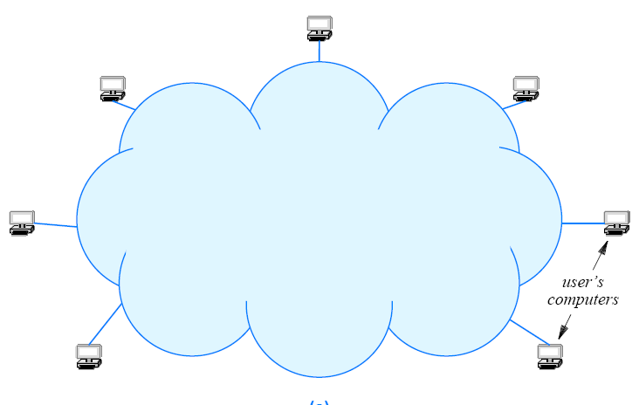
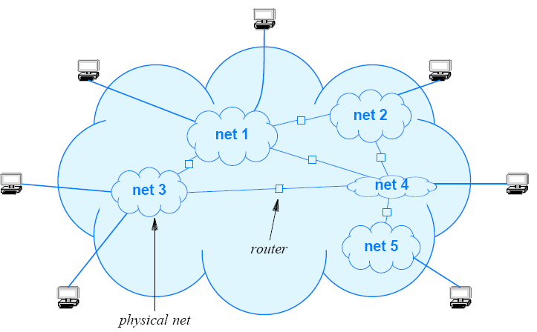
Motivations of Internetworking
The need for ‘universal service’
Logically a single network
A communication system that supplies universal service allows arbitrary pairs of computers to communicate
Notes:
In general, Internet software provides the appearance of a single, seamless communication system to which many computers attach. The system offers universal service: each computer is assigned an address, and any computer can send a packet to any other computer.
We say that an internet is a virtual network system because the communication system is an abstraction. That is, although a combination of hardware and software provides the illusion of a uniform network system, no such network exists. The figure above illustrates the virtual network concept as well as a corresponding physical structure.

Slide 7
Motivations of Internetworking
The need for ‘universal service’
Internet protocol software hides the details of physical network connections, physical addresses, and routing information — neither users nor application programs are aware of the underlying physical networks or the routers that connect them.
That is why we call internet as Virtual Network System
Logically a single network
Notes:
In general, Internet software provides the appearance of a single, seamless communication system to which many computers attach. The system offers universal service: each computer is assigned an address, and any computer can send a packet to any other computer.
We say that an internet is a virtual network system because the communication system is an abstraction. That is, although a combination of hardware and software provides the illusion of a uniform network system, no such network exists. The figure above illustrates the virtual network concept as well as a corresponding physical structure.

Slide 8
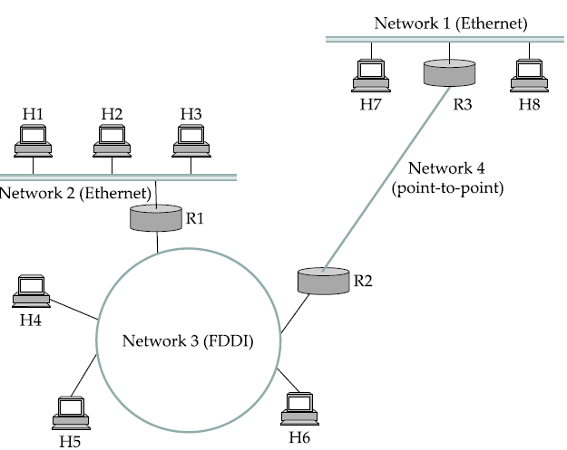
Internetworking example
Source
Notes:
Let’s crystallize the theory we’ve learn up till now with this example.
The source and destination nodes both use Ethernet technology; however, they are on different LANs. The route from the source to the destination goes through networks other than Ethernet (FDDI and PPP). Network 3 and Network 4 cannot understand Ethernet packets. Therefore, the router R1 should send the Ethernet frame as a FDDI frame on network 3 and R2 should send the Ethernet frame as a PPP frame on Network 4.
Network 1 can understand Ethernet frame.
From Douglas Comer’s book: (Free chapter on Internetworking from: http://www.netbook.cs.purdue.edu/PDFdocuments/ch20.pdf)
Each network technology is designed to fit a specific set of constraints. For example, LAN technologies are designed to provide high-speed communication across short distances, while WAN technologies are designed to provide communication across large areas. Consequently,
No single networking technology is best for all needs.
A large organization with diverse networking requirements needs multiple physical networks. More important, if the organization chooses the type of network that is best for each task, the organization will have several types of networks. For example, a LAN technology like Ethernet might be the best solution for connecting computers at a given site, but a leased data circuit might be used to interconnect a site in one city with a site in another.
Concept of Universal Service:
The chief problem with multiple networks should be obvious: a computer attached to a given network can only communicate with other computers attached to the same network. The problem became evident in the 1970s as large organizations began to acquire multiple networks. Each network in the organization formed an island. In many early installations, each computer attached to a single network, and employees had to choose a computer appropriate for each task. That is, an employee was given access to multiple screens and keyboards, and the employee was forced to move from one computer to another to send a message across the appropriate network.
Users are neither satisfied nor productive when they must use a separate computer for each network. Consequently, most modern computer communication systems allow communication between any two computers analogous to the way a telephone system provides communication between any two telephones. Known as universal service, the concept is a fundamental part of networking. With universal service, a user on any computer in any organization can send messages or data to any other user. Furthermore, a user does not need to change computer systems when changing tasks — all information is available to all computers. As a result, users are more productive.
A communication system that supplies universal service allows arbitrary pairs of computers to communicate.
Although universal service is highly desirable, incompatibilities among network hardware, frames, and addresses prevent a bridged network from including arbitrary technologies.
Internetworking
Despite the incompatibilities among network technologies, researchers have devised a scheme that provides universal service among heterogeneous networks. Called internetworking, the scheme uses both hardware and software. Additional hardware systems are used to interconnect a set of physical networks. Software on the attached computers then provides universal service. The resulting system of connected physical networks is known as an internetwork or internet.
The basic hardware component used to connect heterogeneous networks is a router. Physically, a router is an independent hardware system dedicated to the task of interconnecting networks. Like a bridge, a router contains a processor and memory as well as a separate I/O interface for each network to which it connects. The network treats a connection to a router the same as a connection to any other computer.
The figure uses a cloud to depict each network because router connections are not restricted to a particular network technology. A router can connect two LANs, a LAN and a WAN, or two WANs. Furthermore, when a router connects two networks in the same general category, the networks do not need to use the same technology. For example, a router can connect an Ethernet to a Wi-Fi network. Thus, each cloud represents an arbitrary network technology.
An Internet router is a special-purpose hardware system dedicated to the task of interconnecting networks. A router can interconnect networks that use different technologies, including different media, physical addressing schemes, or frame formats.

Slide 9
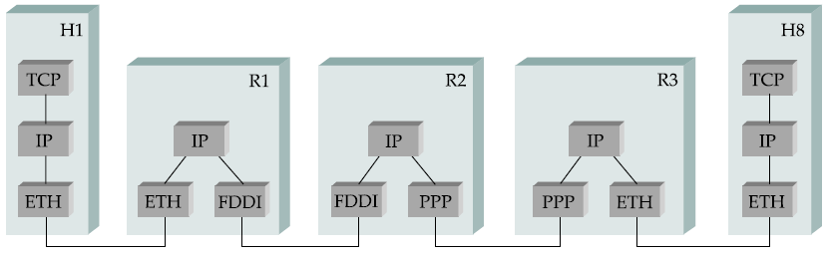
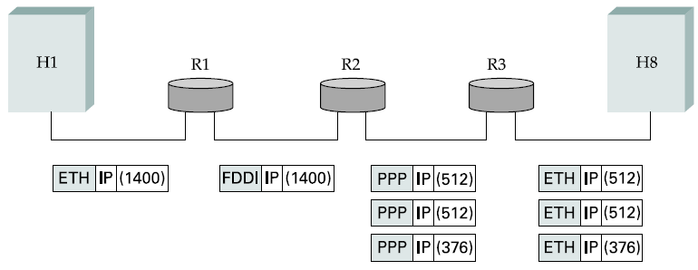
Internetworking example
Handling heterogeneity
Routing Lookup based on Destination IP address
Notes:
Another problem sometimes arises, sometimes network place an upper limit on the size of packet they can deliver.
This is ~1500 bytes for Ethernet and around 600 bytes for PPP. Thus packets will have to be fragmented, these fragmented packets have to be routed to the destination and reassembled at the destination.

Slide 10
Internetworking example
Handling heterogeneity
Add a new MAC header conforming to the protocol supported between R1 and the next-hop (decided by the routing protocol).
Notes:
Another problem sometimes arises, sometimes network place an upper limit on the size of packet they can deliver. This is ~1500 bytes for Ethernet and around 600 bytes for PPP. Thus packets will have to be fragmented, these fragmented packets have to be routed to the destination and reassembled at the destination.

Slide 11
Internetworking example
Issues relating to heterogeneity
Fragmentation and Reassembly
Notes:
Another problem sometimes arises, sometimes network place an upper limit on the size of packet they can deliver. This is ~1500 bytes for Ethernet and around 600 bytes for PPP. Thus packets will have to be fragmented, these fragmented packets have to be routed to the destination and reassembled at the destination.

Slide 12
Internet Protocol (IP)
Protocol of ‘the Internet’
Notes:
Routing refers to determining the route taken by packets from source to destination, and is implemented in the control plane. Forwarding refers to moving packets from a router's input to appropriate router output, and is implemented in the data plane.

Slide 13
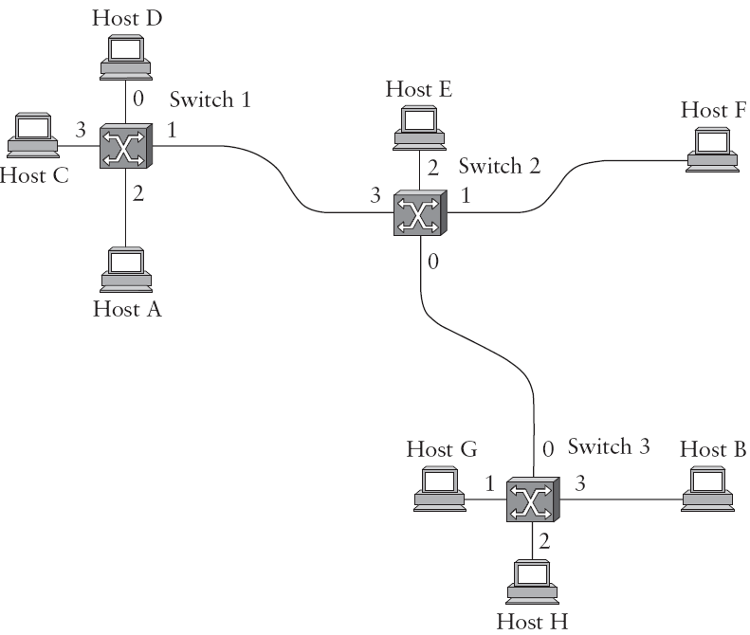
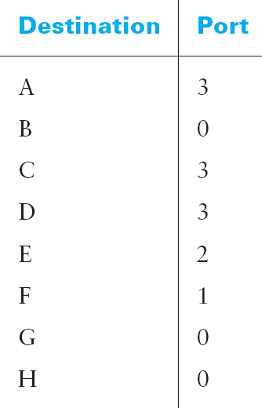
IP takes datagram approach
This service model is sometimes called best effort because, although IP makes every effort to deliver datagrams, it makes no guarantees.
Forwarding table at Switch 2
Notes:
The IP service model can be thought of as having two parts: an addressing scheme, which provides a way to identify all hosts in the internetwork, and a datagram (connectionless) model of data delivery. This service model is sometimes called best effort because, although IP makes every effort to deliver datagrams, it makes no guarantees.
Connectionless (datagram) networks have the following characteristics:
■ A host can send a packet anywhere at any time, since any packet that turns up at a switch can be immediately forwarded (assuming a correctly populated forwarding table). As we will see, this contrasts with most connection-oriented networks, in which some “connection state” needs to be established before the first data packet is sent.
■ When a host sends a packet, it has no way of knowing if the network is capable of delivering it or if the destination host is even up and running.
■ Each packet is forwarded independently of previous packets that might have been sent to the same destination. Thus, two successive packets from host A to host B may follow completely different paths (perhaps because of a change in the forwarding table at some switch in the network).
■ A switch or link failure might not have any serious effect on communication if it is possible to find an alternate route around the failure and to update the forwarding table accordingly.

Slide 14
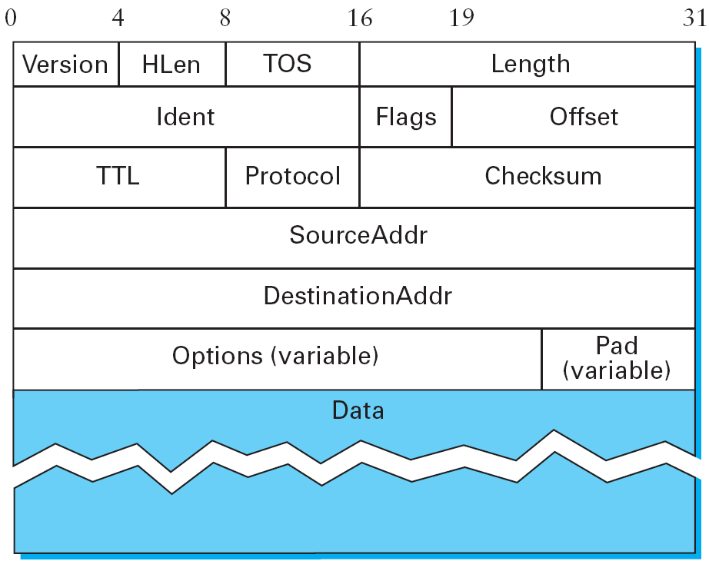
IP Packet Format
QoS
H+D
(for Frag.)
(0, DF, MF)
If 0;
destroy
Header
Notes:
Clearly, a key part of the IP service model is the type of packets that can be carried. The IP datagram, like most packets, consists of a header followed by a number of bytes of data.
The Version field specifies the version of IP. The current version of IP is 4, and it is sometimes called IPv4. Observe that putting this field right at the start of the datagram makes it easy for everything else in the packet format to be redefined in subsequent versions; the header processing software starts off by looking at the version and then branches off to process the rest of the packet according to the appropriate format. The next field, HLen, specifies the length of the header in 32-bit words. When there are no options, which is most of the time, the header is 5 words (20 bytes) long. The 8-bit TOS (type of service) field has had a number of different definitions over the years, but its basic function is to allow packets to be treated differently based on application needs. For example, the TOS value might determine whether or not a packet should be placed in a special queue that receives low delay.
The next 16 bits of the header contain the Length of the datagram, including the header. Unlike the HLen field, the Length field counts bytes rather than words. Thus, the maximum size of an IP datagram is 65,535 bytes. The physical network over which IP is running, however, may not support such long packets. For this reason, IP supports a fragmentation and reassembly process.
Moving on to the third word of the header, the next byte is the TTL (time to live) field. Its name reflects its historical meaning rather than the way it is commonly used today. The intent of the field is to catch packets that have been going around in routing loops and discard them, rather than let them consume resources indefinitely. Originally, TTL was set to a specific number of seconds that the packet would be allowed to live, and routers along the path would decrement this field until it reached 0. However, since it was rare for a packet to sit for as long as 1 second in a router, and routers did not all have access to a common clock, most routers just decremented the TTL by 1 as they forwarded the packet.
The Protocol field is simply a de-multiplexing key that identifies the higher-level protocol to which this IP packet should be passed. There are values defined for TCP (6), UDP (17), and many other protocols that may sit above IP in the protocol graph.
The Checksum is calculated by considering the entire IP header as a sequence of 16-bit words, adding them up using ones complement arithmetic, and taking the ones complement of the result. This is the IP checksum algorithm described in previous lectures.
Thus, if any bit in the header is corrupted in transit, the checksum will not contain the correct value upon receipt of the packet. Since a corrupted header may contain an error in the destination address—and, as a result, may have been misdelivered—it makes sense to discard any packet that fails the checksum. It should be noted that this type of checksum does not have the same strong error detection properties as a CRC, but it is much easier to calculate in software.

Slide 15
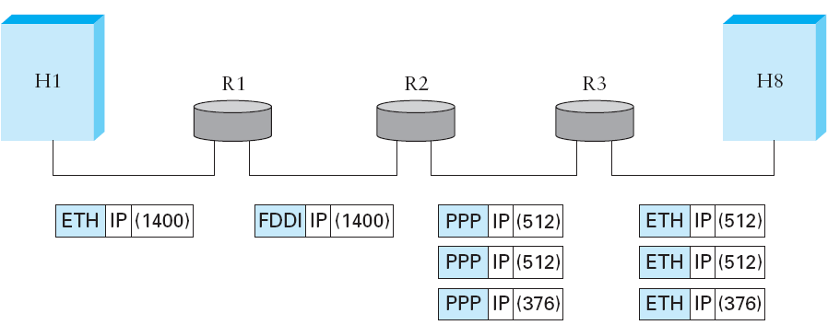
Fragmentation & Reassembly
Notes:
One of the problems of providing a uniform host-to-host service model over a heterogeneous collection of networks is that each network technology tends to have its own idea of how large a packet can be. For example, an Ethernet can accept packets up to 1500 bytes long, while FDDI packets may be 4500 bytes long. This leaves two choices for the IP service model: make sure that all IP datagrams are small enough to fit inside one packet on any network technology, or provide a means by which packets can be fragmented and reassembled when they are too big to go over a given network technology. The latter turns out to be a good choice, specially when you consider the fact that new network technologies are always turning up, and IP needs to run over all of them; this would make it hard to pick a suitably small bound on datagram size. This also means that a host will not send needlessly small packets, which wastes bandwidth and consumes processing resources by requiring more headers per byte of data sent. For example, two hosts connected to FDDI networks that are interconnected by a point-to-point link would not need to send packets small enough to fit on an Ethernet.
The central idea here is that every network type has a maximum transmission unit (MTU), which is the largest IP datagram that it can carry in a frame. Note that this value is smaller than the largest packet size on that network because the IP datagram needs to fit in the payload of the link-layer frame.
When a host sends an IP datagram, therefore, it can choose any size that it wants. A reasonable choice is the MTU of the network to which the host is directly attached. Then fragmentation will only be necessary if the path to the destination includes a network with a smaller MTU. Should the transport protocol that sits on top of IP give IP a packet larger than the local MTU, however, then the source host must fragment it.
Fragmentation typically occurs in a router when it receives a datagram that it wants to forward over a network that has an MTU that is smaller than the received datagram. To enable these fragments to be reassembled at the receiving host, they all carry the same identifier in the Ident field. This identifier is chosen by the sending host and is intended to be unique among all the datagrams that might arrive at the destination from this source over some reasonable time period. Since all fragments of the original datagram contain this identifier, the reassembling host will be able to recognize those fragments that go together. Should all the fragments not arrive at the receiving host, the host gives up on the reassembly process and discards the fragments that did arrive. IP does not attempt to recover from missing fragments.
To see what this all means, consider what happens when host H1 sends a datagram to host H8 in the example internet shown in Figure 4.1 (of your textbook). Assuming that the MTU is 1500 bytes for the two Ethernets, 4500 bytes for the FDDI network, and 532 bytes for the point-to-point network, then a 1420-byte datagram (20-byte IP header plus 1400 bytes of data) sent from H1 makes it across the first Ethernet and the FDDI network without fragmentation but must be fragmented into three datagrams at router R2. These three fragments are then forwarded by router R3 across the second Ethernet to the destination host. This situation is illustrated in the figure above. This figure also serves to reinforce two important points:
Each fragment is itself a self-contained IP datagram that is transmitted over a sequence of physical networks, independent of the other fragments.
Each IP datagram is re-encapsulated for each physical network over which it travels.

Slide 16
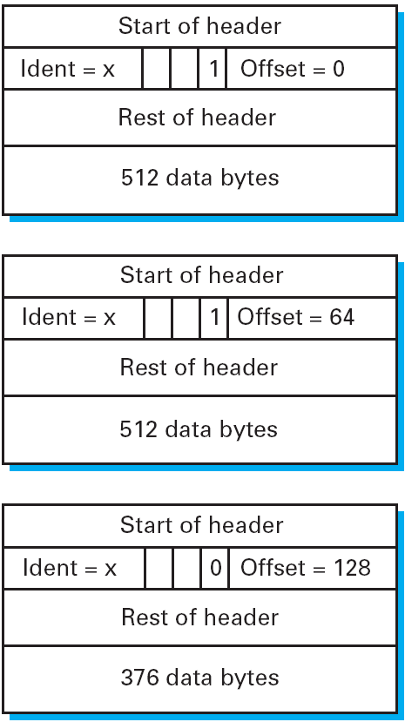
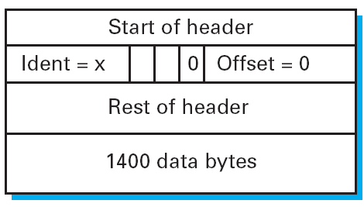
Fragmentation & Reassembly
Notes:
The fragmentation process can be understood in detail by looking at the header fields of each datagram, as is done in Figure 4.5. The unfragmented packet, shown at the top, has 1400 bytes of data and a 20-byte IP header. When the packet arrives at router R2, which has an MTU of 532 bytes, it has to be fragmented. A 532-byte MTU leaves 512 bytes for data after the 20-byte IP header, so the first fragment contains 512 bytes of data. The router sets the Mbit in the Flags field (see Figure 4.3 of your textbook), meaning that there are more fragments to follow, and it sets the Offset to 0, since this fragment contains the first part of the original datagram. The data carried in the second fragment starts with the 513th byte of the original data, so the Offset field in this header is set to 64, which is 512 ÷ 8. Why the division by 8? Because the designers of IP decided that fragmentation should always happen on 8-byte boundaries, which means that the Offset field counts 8-byte chunks, not bytes. (The IPv4 header allocates only 13 bits to the Offset field, but a packet’s length can be up to 2^16 − 1. In order to support fragmentation of a maximum-sized packet, we must count offsets in multiples of 2^(16−13) = 2^3 bytes.) The third fragment contains the last 376 bytes of data, and the offset is now 2 × 512 ÷ 8 = 128. Since this is the last fragment, the M bit is not set.
Observe that the fragmentation process is done in such a way that it could be repeated if a fragment arrived at another network with an even smaller MTU. Fragmentation produces smaller, valid IP datagrams that can be readily reassembled

Slide 17
Fragmentation & Reassembly
Notes:
The fragmentation process can be understood in detail by looking at the header fields of each datagram, as is done in Figure 4.5. The unfragmented packet, shown at the top, has 1400 bytes of data and a 20-byte IP header. When the packet arrives at router R2, which has an MTU of 532 bytes, it has to be fragmented. A 532-byte MTU leaves 512 bytes for data after the 20-byte IP header, so the first fragment contains 512 bytes of data. The router sets the Mbit in the Flags field (see Figure 4.3 of your textbook), meaning that there are more fragments to follow, and it sets the Offset to 0, since this fragment contains the first part of the original datagram. The data carried in the second fragment starts with the 513th byte of the original data, so the Offset field in this header is set to 64, which is 512 ÷ 8. Why the division by 8? Because the designers of IP decided that fragmentation should always happen on 8-byte boundaries, which means that the Offset field counts 8-byte chunks, not bytes. (The IPv4 header allocates only 13 bits to the Offset field, but a packet’s length can be up to 2^16 − 1. In order to support fragmentation of a maximum-sized packet, we must count offsets in multiples of 2^(16−13) = 2^3 bytes.) The third fragment contains the last 376 bytes of data, and the offset is now 2 × 512 ÷ 8 = 128. Since this is the last fragment, the M bit is not set.
Observe that the fragmentation process is done in such a way that it could be repeated if a fragment arrived at another network with an even smaller MTU. Fragmentation produces smaller, valid IP datagrams that can be readily reassembled

Slide 18
Internet Protocol (IP)
Protocol of ‘the Internet’
Classful/ Classless IP addressing
/25
/28
/24
A classful network is a network addressing architecture used in the Internet from 1981 until the introduction of Classless Inter-Domain Routing in 1993.
/27
/26
/28

Slide 19
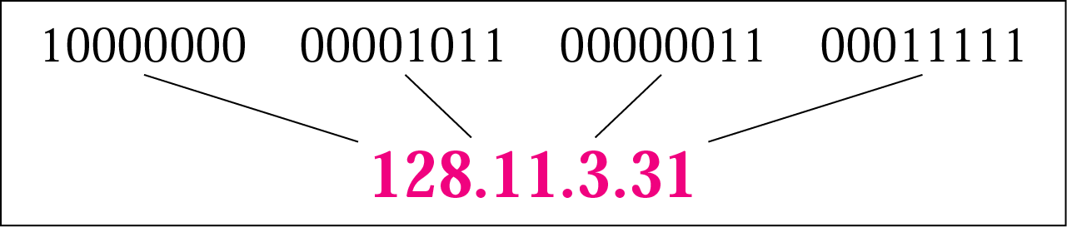
Internet Protocol
4,294,967,296
possible addresses = 2³²
IP Version 4; Address: 32 bits
IP Version 6; Address: 128 bits
Hierarchical addressing
2 parts: network, host determined by subnet mask
Notes:
Internet Protocol (IP) comes in two main versions: IPv4 and IPv6.
In an IPv4 address, that comprises of 32 bits, there are two parts by design. The first part is called the network part, and the second part is called the host part.

Slide 20
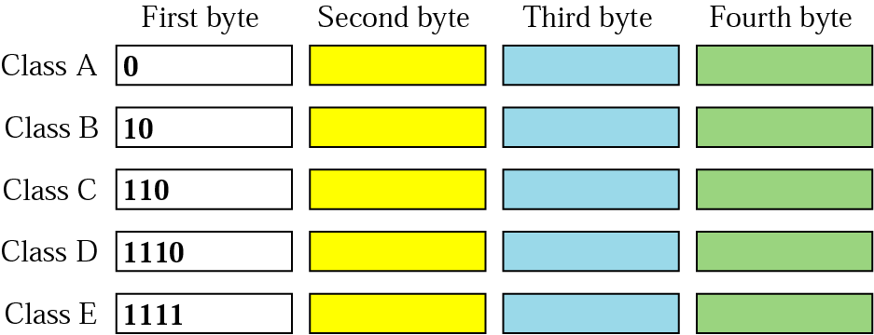
Classful IP addresses
Notes:
Internet Protocol (IP) comes in two main versions: IPv4 and IPv6.
In an IPv4 address, that comprises of 32 bits, there are two parts by design. The first part is called the network part, and the second part is called the host part.
Only 127 networks can exist in class A. The default subnet mask sets the de facto boundary that first octet bits cannot be borrowed for assigning hosts addresses.
0.0 to 127.255. 255.255 , with a default mask of 255.0. 0.0 (or /8 in CIDR). This means that Class A addressing can have a total of 128 (2⁷) networks and 16,777,214 (2²⁴-2) usable addresses per network
Another question which arises is for what purpose addresses between 128.0.0.0 - 255.0.0.0 are used for?

Slide 21
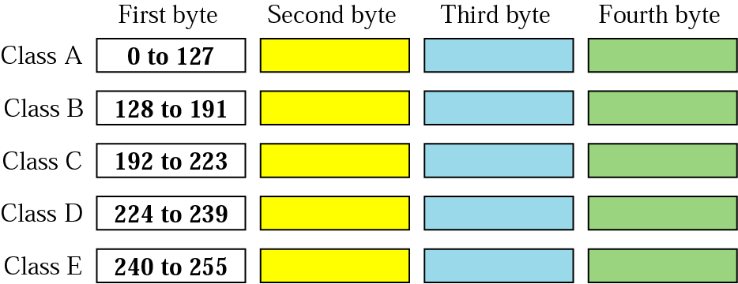
Classful IP addresses
Notes:
Internet Protocol (IP) comes in two main versions: IPv4 and IPv6.
In an IPv4 address, that comprises of 32 bits, there are two parts by design. The first part is called the network part, and the second part is called the host part.

Slide 22
Classful IP addresses
Depending on the size of the network, IP-based networks are divided into three classes. · Class A- Class A networks are mega monster networks with up to 224 nodes 16 million plus. Class A networks have their network addresses from 1.0.0.0 to 126.0.0.0, with the zero's being replaced by node addresses.
· Class B- Class B networks are smaller networks in comparison they can have only about 65,000 nodes! Network addresses for these ranges from 128.0.0.0 to 191.0.0.0. Here the last two zeros get replaced by the node addresses.
· Class C- These are the baby networks that can have only 254 nodes at the maximum. The network IP addresses for these range from 192.0.0.0 to 223.0.0.0.
Notes:
Internet Protocol (IP) comes in two main versions: IPv4 and IPv6.
In an IPv4 address, that comprises of 32 bits, there are two parts by design. The first part is called the network part, and the second part is called the host part.

Slide 23
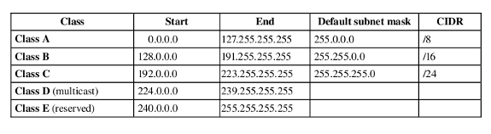
IP (Internet Protocol)
IP is divided into 5 classes of network addresses based on the range of first octet. The subnet masks tells how many octets are used for network and hosts.
Who assigns IP addresses:
IANA (Internet Assigned Numbers authority). To communicate over an internet, a device must have a public IP address which is provided by IANA (Internet Assigned Numbers Authority). Private range of IP addresses are used in an intranet (an internal network that uses internet technology). IANA also provides address for private networks in each class.
Notes:
Courtesy: http://www.smartpctricks.com/2013/03/ip-address-classes-and-ranges-explained-with-subnet-mask.html
http://www.cse.uconn.edu/~vcb5043/MISC/IP%20Intranet.html
There is quite a disparity in the number of hosts available for each network in each of these classes. What happens if an organization needs 1,000 IP addresses? They have to either use four class Cs or use one class B (and in so doing waste over 90% of the possible addresses in the class B network.) Bear in mind that there are only about 16,000 class B network IDs available worldwide

Slide 24
IP (Internet Protocol)
Out of the total valid addresses in each class, two dedicated IP address is reserved for;
Network address
Broadcast address
So the total number of available IP addresses will be 2^{n}-2
Notes:
Courtesy: http://www.smartpctricks.com/2013/03/ip-address-classes-and-ranges-explained-with-subnet-mask.html
http://www.cse.uconn.edu/~vcb5043/MISC/IP%20Intranet.html
There is quite a disparity in the number of hosts available for each network in each of these classes. What happens if an organization needs 1,000 IP addresses? They have to either use four class Cs or use one class B (and in so doing waste over 90% of the possible addresses in the class B network.) Bear in mind that there are only about 16,000 class B network IDs available worldwide

Slide 25
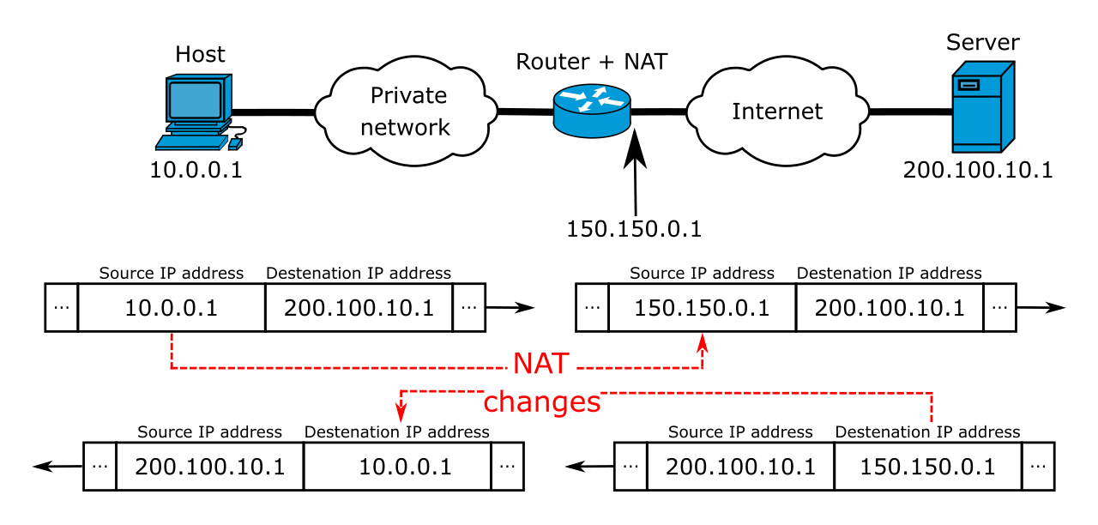
Classful IP addresses
Private IP addresses
A 10.0.0.0 10.255.255.255
B 172.16.0.0 172.31.255.255
C 192.168.0.0 192.168.255.255
Notes:
Network Address Translation makes use of three ranges of IP addresses that have been declared as private. Networks use them internally as they wish. The only rule is that no packets containing these addresses may appear on the internet itself.
Image courtesy wikipedia

Slide 26
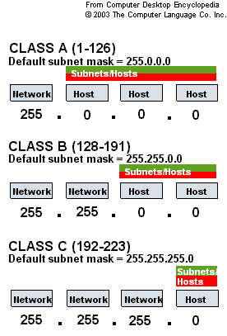
Subnet Mask

Slide 27
Subnetting – Advantages
In an IP network, every machine on the same physical network sees all the data packets sent out on the network. As the number of computers on a network grows, network traffic will grow many fold.
Dividing a network into different subnetworks minimize the traffic across the different subnetworks. Interconnectivity between the different subnets would be provided by routers, which will only transmit data meant for another subnet across itself.
To divide a given network address into two or more subnets, you use subnet masks. The default subnet masks for class A networks is 255.0.0.0, for class B is 255.255.0.0, and for class C is 255.255.255.0, which signify a network without subnets.
Notes:
https://community.spiceworks.com/networking/articles/2476-why-subnet-your-network-the-benefits-of-subnetting

Slide 28
Classless (VLSM): Subnetting
202.125.138.0/24
202.125.138.0 – 202.125.138.255
202.125.138.0/25
202.125.138.128/25
202.125.138.0 – 202.125.138.127
202.125.138.128 – 202.125.138.255
Borrowing one host bit provides two subnetworks
Notes:
Internet Protocol (IP) comes in two main versions: IPv4 and IPv6.
In an IPv4 address, that comprises of 32 bits, there are two parts by design. The first part is called the network part, and the second part is called the host part.

Slide 29
Subnetting
202.125.138.0/24
202.125.138.0 – 202.125.138.255
202.125.138.0/26
202.125.138.192/26
202.125.138.0 – 202.125.138.63
202.125.138.192 – 202.125.138.255
202.125.138.64/26
202.125.138.128/26
202.125.138.64 – 202.125.138.127
202.125.138.128 – 202.125.138.191
Borrowing two host bits provide four subnetworks
Notes:
Internet Protocol (IP) comes in two main versions: IPv4 and IPv6.
In an IPv4 address, that comprises of 32 bits, there are two parts by design. The first part is called the network part, and the second part is called the host part.

Slide 30
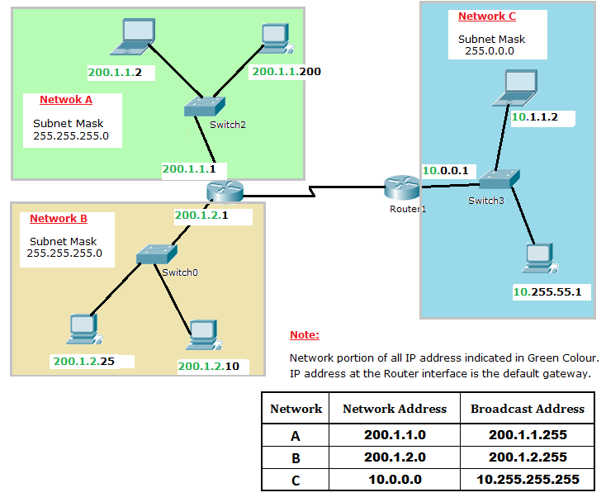

Slide 31
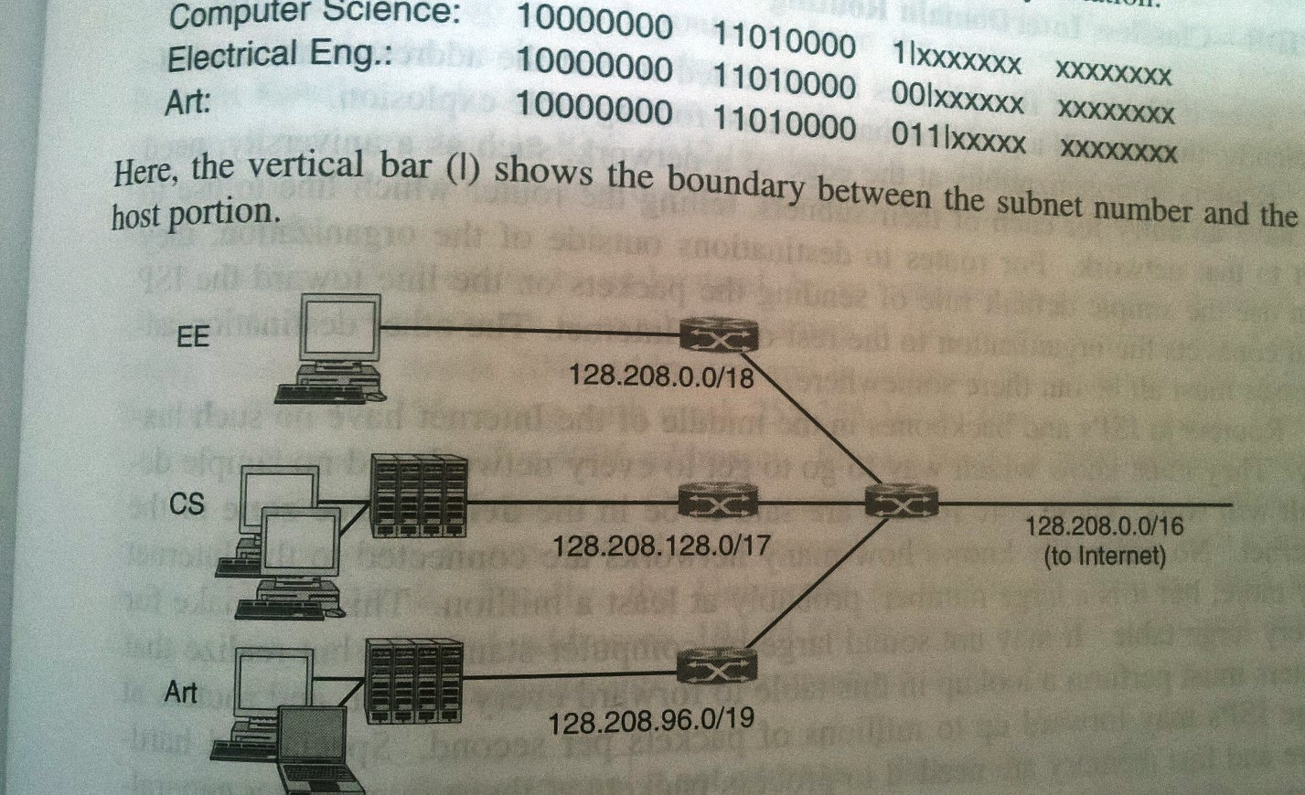
Subnetting
Notes:
Internet Protocol (IP) comes in two main versions: IPv4 and IPv6.
In an IPv4 address, that comprises of 32 bits, there are two parts by design. The first part is called the network part, and the second part is called the host part.

Slide 32
Subnetting – Exercise
Network address = 192.168.1.0 = 11000000.10101000.00000001.00000000
Default subnet for class C = 255.255.255.0 = 11111111.11111111.11111111.00000000
Adding 8 subnets= 11111111.11111111.11111111.11100000
Write the range of Subnets in decimal format. Also mention Network Address and Broadcast address of each subnet.
Notes:
http://www.techrepublic.com/article/build-your-skills-subnetting-and-supernetting-ip-networks/

Slide 33
Supernetting
Supernetting is the opposite of Subnetting. In subnetting, a single big network is divided into multiple smaller subnetworks. In Supernetting, multiple networks are combined into a bigger network termed as a Supernetwork or Supernet.
Supernetting is used in route aggregation to reduce the size of routing tables and routing table updates

Slide 34
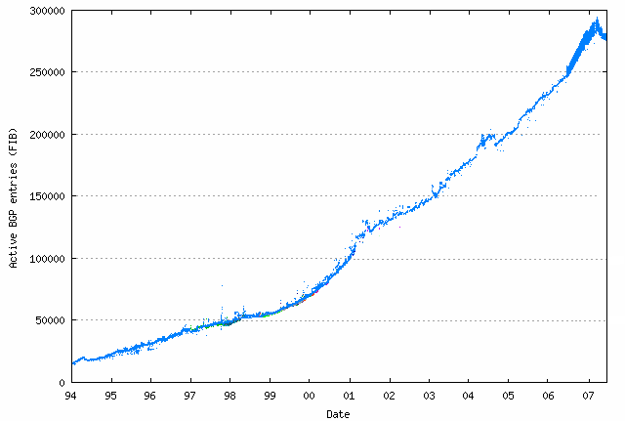
Growth of Routing Table
Projected growth of routing table before CIDR
But still the routing table grows
CIDR worked for a while
Source: http://potaroo.net
Notes:
We restate an important distinction, which is often neglected, between forwarding and routing. Forwarding consists of taking a packet, looking at its destination address, consulting a table, and sending the packet in a direction determined by that table. We saw several examples of forwarding in the preceding section. Routing is the process by which forwarding tables are built. We also note that forwarding is a relatively simple and well-defined process performed locally at a node, whereas routing depends on complex distributed algorithms that have continued to evolve throughout the history of networking.

Slide 35
CIDR (Classless Interdomain Routing)
CIDR uses both subnetting and supernetting
Subnetting – efficient usage of IP addresses
Supernetting – allows more efficient routing
Supernetting
/25
/24
network
/24
/24
Subnetting
/25

Slide 36

Supernet (Route aggregation)
202.125.138.0/26
202.125.138.0/26; 202.125.138.64/26; 202.125.138.128/26; 202.125.138.192/26
are directly connected to me
202.125.138.0/24
is directly connected to me
202.125.138.64/26
202.125.138.128/26
Supernetting helps reduce the size of routing tables routers have to store
202.125.138.192/26
Notes:
Internet Protocol (IP) comes in two main versions: IPv4 and IPv6.
In an IPv4 address, that comprises of 32 bits, there are two parts by design. The first part is called the network part, and the second part is called the host part.

Slide 37
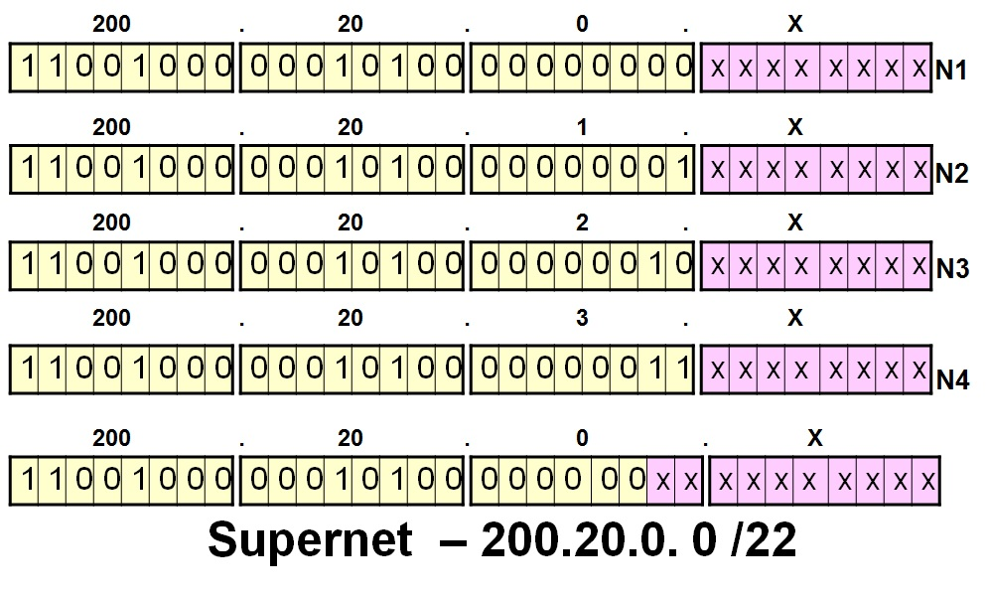
Supernet (Route aggregation)
Notes:
Internet Protocol (IP) comes in two main versions: IPv4 and IPv6.
In an IPv4 address, that comprises of 32 bits, there are two parts by design. The first part is called the network part, and the second part is called the host part.

Slide 38
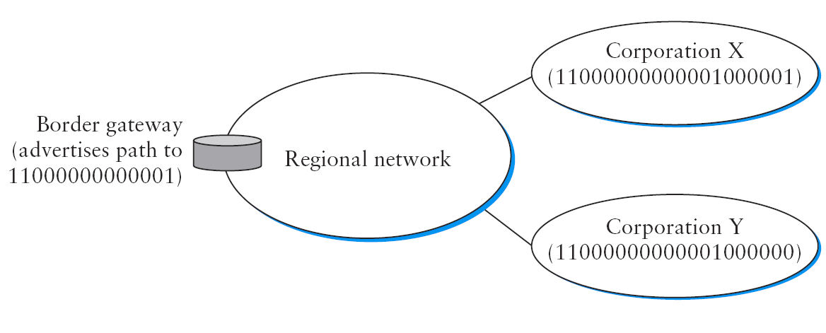
CIDR (Classless Interdomain Routing)
192.4.16.0/20
.
.
.
192.4.0.0/14
.
.
Contains 2⁶ (20 bit: /20) prefixes including the two prefixes on RHS
192.4.0.0/20
To only advertise the two /20 prefixes on RHS, use 192.4.0.0/19
Notes:
http://searchnetworking.techtarget.com/definition/supernetting

Slide 39
Block of Addresses
ISP’s block 202.23.16.0/20 11001000 00010111 00010000 00000000
ISP allocates IP blocks to clients, from its own block
Org. A 202.23.16.0/23 11001000 00010111 00010000 00000000
Org. B 202.23.18.0/23 11001000 00010111 00010010 00000000
Org. C 202.23.20.0/23 11001000 00010111 00010100 00000000
… … …
Org. D 202.23.20.0/23 11001000 00010111 00011110 00000000
202.23.20.0/23 11001000 00010111 00011111 11111111
First
Last
IP Address Prefix
(Network Part)
510 (2⁹=512-2) hosts on each subnet
3 bits taken from host bits provide 8 subnets

Slide 40
Supernetting – Exercise
Network address = 192.168.1.0 = 11000000.10101000.00000001.00000000
Default subnet for class C = 255.255.255.0 = 11111111.11111111.11111111.00000000
Adding 8 subnets= 11111111.11111111.11111111.11100000
In the previous example you all created eight subnets in decimal format. What will be the super-net address for them which can be allocated to the Router.
Notes:
https://community.spiceworks.com/networking/articles/2476-why-subnet-your-network-the-benefits-of-subnetting

Slide 41
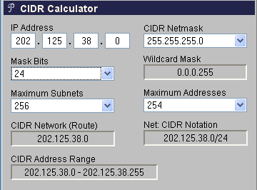
CIDR (Classless Interdomain Routing)
http://www.subnet-calculator.com/cidr.php
Notes:
Internet Protocol (IP) comes in two main versions: IPv4 and IPv6.
In an IPv4 address, that comprises of 32 bits, there are two parts by design. The first part is called the network part, and the second part is called the host part.
The designers

Slide 42

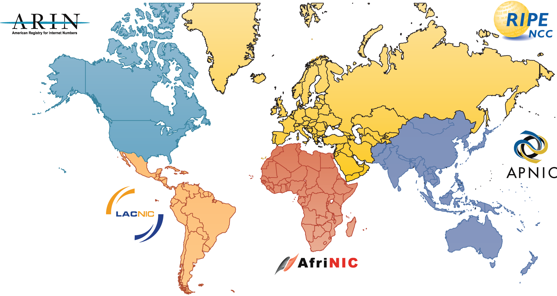
Sidenote: How to get IP addresses?
RIRs
PKNIC
Notes:
A regional Internet registry (RIR) is an organization overseeing the allocation and registration of Internet number resources within a particular region of the world. Resources include IP addresses (both IPv4 and IPv6) and autonomous system numbers (for use in BGP routing).
Regional Internet Registries
There are currently five RIRs in operation:
American Registry for Internet Numbers (ARIN) ^{[1]} for North America and parts of the Caribbean RIPE Network Coordination Centre (RIPE NCC) ^{[2]} for Europe, the Middle East and Central Asia Asia-Pacific Network Information Centre (APNIC) ^{[3]} for Asia and the Pacific region Latin American and Caribbean Internet Addresses Registry (LACNIC) ^{[4]} for Latin America and parts of the Caribbean region African Network Information Centre (AfriNIC) ^{[5]} for Africa
[edit] The relationship between RIRs and IANA
The Internet Assigned Numbers Authority (IANA) delegates Internet resources to the RIRs who, in turn, follow their regional policies to delegate resources to their customers, which include Internet service providers and end-user organizations. Collectively, the RIRs participate in the Number Resource Organization (NRO),^{[6]} formed as a body to represent their collective interests, undertake joint activities, and coordinate their activities globally. The NRO has entered into an agreement with ICANN for the establishment of the Address Supporting Organisation (ASO),^{[7]} which undertakes coordination of global IP addressing policies within the ICANN framework.

Slide 43
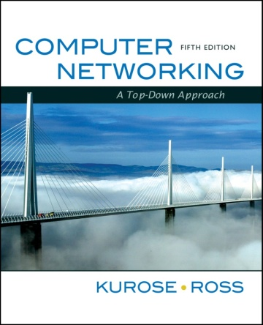
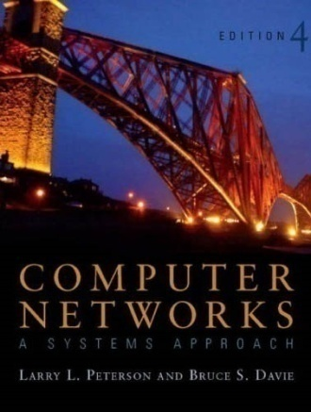
References
Chapter 4:
The Network Layer [K&R]
Section 4.4 (in particular)
Chapter 4:
Internetworking [P&D]
Section 4.1.1 to 4.1.4

Slide 44
[ End of lecture ]

